Slide 1

AI
Mapping and Visual Analysis of Vocational Career with personality trait based on Big Five and Holland’s code using Machine Learning
V Karthick, Associate Professor
Department of Computer Science and Engineering,
Rajalakshmi Engineering College,
Chennai - 602105.
vkarthick86@gmail.com
Swathi S
Department of Computer Science and Engineering,
Rajalakshmi Engineering College,
Chennai - 602105.
210701274@rajalakshmi.edu.in
Tejashree D
Department of Computer Science and Engineering,
Rajalakshmi Engineering College,
Chennai - 602105.
210701287@rajalakshmi.edu.in

Slide 2
Abstract
Working professionals often feel burnt out and lose interest in their domain due to career dissatisfaction. Lack of choosing a career path aligned with personal interests. Our study helps the students to choose careers based on their unique traits and personality. To address this challenge, this project helps students and children to choose their career according to their particular traits and personality. This system is trained and data predictive models by using repositories of personality traits using Big Five Personality - and mapping each of the personality to Holland’s code vocational career namely RIASEC. By analyzing these models, children can have an idea to pick their career. The integration of K-Means Clustering analyzes personality data to find patterns or groupings that could be useful in psychological research, career counseling, or personal development. Neural Networks present novel opportunities for capturing intricate patterns in customer data and improving churn prediction capabilities.

Slide 3
In previous research, the comparison between the ML-augmented method and the traditional profile method in predicting occupational aspiration has been made. The ML-augmented method outperforms the traditional profile method by achieving a higher hit rate of 0.38 and latter having 0.33, thereby marking superior prediction accuracy by ML- augmented method. On the other hand, this paper aims to train data predictive models by using repositories of personality traits using Big Five Personality - and mapping each of the personality to Holland’s code vocational career namely RIASEC. By analyzing these models, children can have an idea to pick their career. The integration of K-Means Clustering analyzes personality data to find patterns or groupings that could be useful in psychological research, career counseling, or personal development. Further, each cluster is analyzed using silhouette scores and inertia scores. The mapping of the RIASEC is visualized using heat maps and radar charts.

Slide 4
Introduction
The project explores the relationship between vocational career prediction and personality traits. It focuses on correlating Holland’s code (RIASEC) and the Big Five personality traits. Holland’s code categorizes occupations into six types: Realistic, Investigative, Artistic, Social, Enterprising and Conventional. The Big Five personality traits are Openness, Conscientiousness, Neuroticism, Agreeableness, and Extraversion. Machine learning algorithms map each Big Five trait to corresponding RIASEC types. Visual insights are provided to enhance understanding. Earlier studies focused on either Big Five or RIASEC separately. This project integrates both models and provides visual representations. Although some studies mapped using psychological factors but did not show visual insights. This grew the motivation behind this paper to be developed. This involves clustering individuals based on their personality surveys and mapping them with RIASEC code, and finally showing visual insights. This study can also help researchers from different fields like psychology, sociology, and data science collaborate to gain deeper insights into human behavior.

Slide 5
Literature Review
PAPER | AUTHORS | DATE PUBLISHED | REVIEW
 | F. Mairesse, M. A. Walker, M. R. Mehl, and R. K. Moore | 2022 | The authors propose methods for leveraging linguistic features to accurately identify personality traits, advancing the understanding of how language relates to individual characteristics.
Fast clustering for single cell data using mini-batch k-means,” PLoS computational biology | Hicks, S.C., R. Liu, Y. Ni, E. Purdom, and D. Risso | 2021 | It utilizes a set of hand-engineered features, such as LIWC, SenticNet, NRC Emotion Lexicon, VAD Lexicon, and readability measures.
What is beyond the Big Five? | Saucier, Gerard, and Lewis R. Goldberg | 2023 | This paper is about the 1-D CNN n-grams model achieved the personality prediction performance.
Personality and Person-Work Environment Fit” | Batista, Jonatan Santana, Sônia Maria Guedes Gondim. | 2023 | Conducted a comprehensive review of recent advancements in deep learning-based automated personality prediction.
Using linguistic cues for the automatic recognition of personality in conversation and text.

Slide 6
Literature Review
PAPER | AUTHORS | DATE PUBLISHED | REVIEW
 | M. A. Hearst, S. T. Dumais, E. Osuna, J. Platt, and B. Scholkopf | 2024 | The authors give an in-depth review of SVMs, covering its theoretical basis, optimization approaches, and practical applications in a variety of disciplines.
Personality trait detection using bagged svm over bert word embedding ensembles | A. Kazameini, S. Fatehi, Y. Mehta, S. Eetemadi, E. Cambria | 2020 | Improve the accuracy and robustness of personality detection systems by integrating SVM with BERT word embeddings.
Recent trends in deep learning based personality detection | Y. Mehta, N. Majumder, A. Gelbukh, and E. Cambria | 2020 | The authors review the many procedures and techniques used in the field, including advances in neural network topologies, training tactics, and feature extraction methods.
The hourglass model revisited | Y. Susanto, A. Livingstone | 2020 | The new Hourglass model improved the accuracy of personality prediction.
Support vector machines, Intelligent Systems and their applications

Slide 7
Research Gap
Most of the studies focussed on either the Big 5 personality or RIASEC model separately.
Although some studies mapped using psychological factors but did not show visual insights. This grew the motivation behind this paper to be developed.
This involves clustering individuals based on their personality surveys and mapping them with RIASEC code, and finally showing visual insights.
This study can also help researchers from different fields like psychology, sociology, and data science collaborate to gain deeper insights into human behavior.

Slide 8
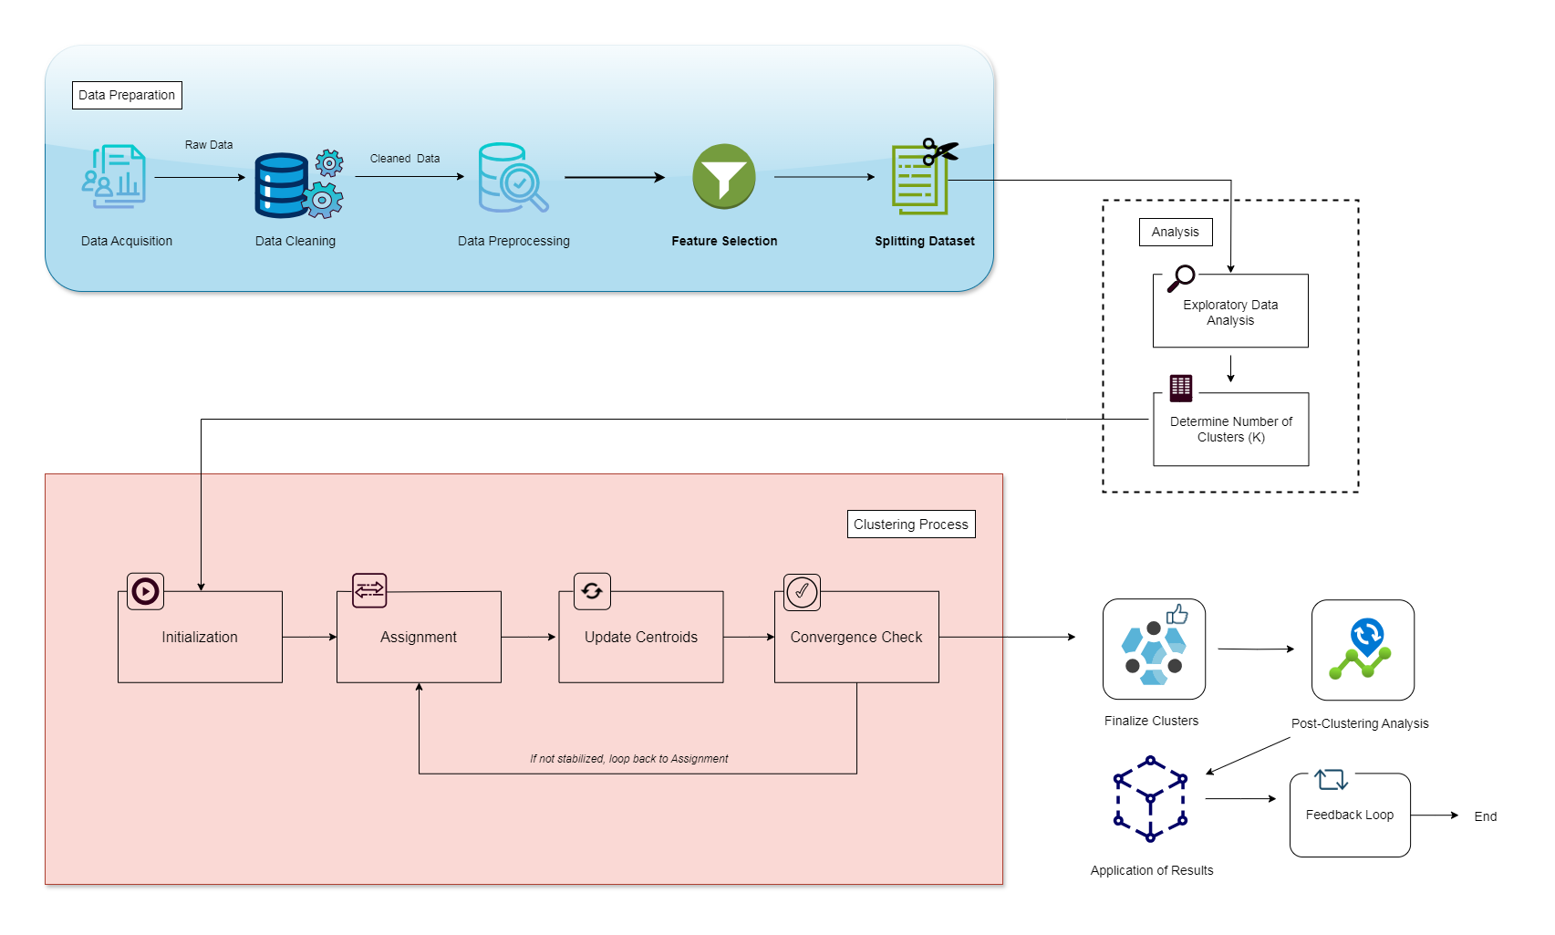
Methodology - Architecture Diagram

Slide 9

Methodology - Flow
Data Acquistion
Data Cleaning and Preprocessing
Feature Selection
Understanding the basics of AI and its potential implications
Mapping Traits to RIASEC Codes
Silhouette score and inertia score evaluation
Splitting Dataset and cluster forming
Map identified clusters to Holland's RIASEC codes for career recommendations.
Visualization
Generate heatmaps and scatter plots to visualize trait and career correlations.

Slide 10
Conclusion
In this study, we presented a comprehensive approach to address the challenge of guiding individuals, particularly young students, in making informed career choices aligned with their interests and traits by visualizing their relationship. The project utilized a combination of Holland's RIASEC model and the Big Five Personality traits, using machine learning algorithms to predict vocational career paths. Overall, the project represents a significant step towards empowering the next generation to make meaningful and fulfilling career choices.

Slide 11
Future Work
Future work could focus on further refining the predictive models through larger and more diverse datasets. Additionally, integrating additional factors such as aptitude tests, personal values, and preferences could enhance the accuracy and relevance of career predictions. In addition, creating a system for parents who can record down their childrens’ day-to-day activities which in turn can forecast what coursework would interest their children.

Slide 12
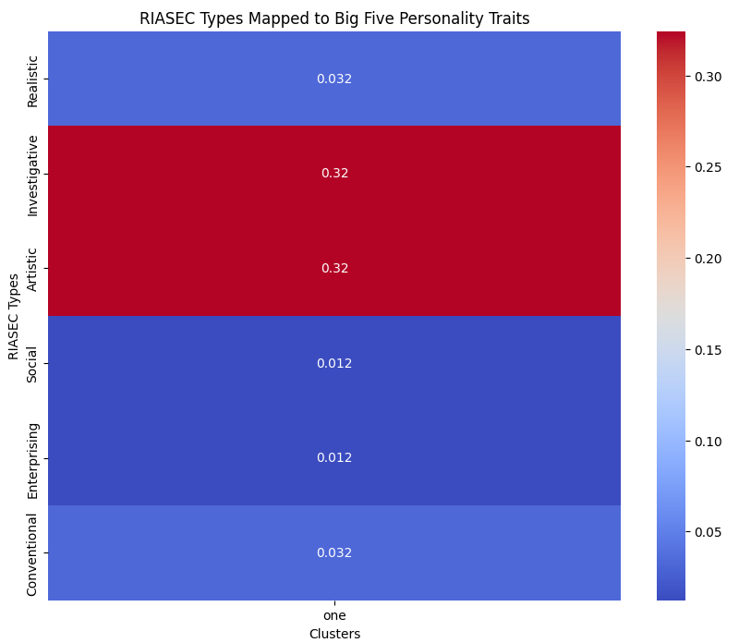
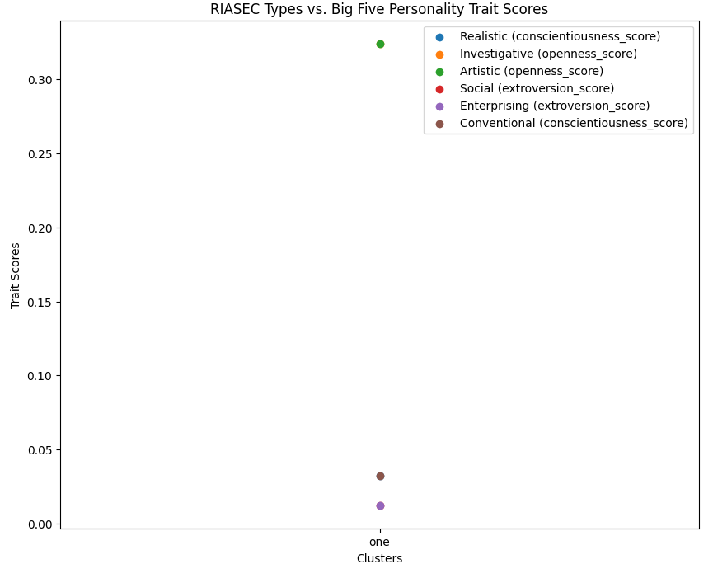
AI
Results
Fig 2 Scatterplot of cluster 1
Fig 1 RIASEC Types Mapped to Big Five Personality
Trait Scores for cluster 1
Inference : Realistic individuals tend to be more conscientious!

Slide 13
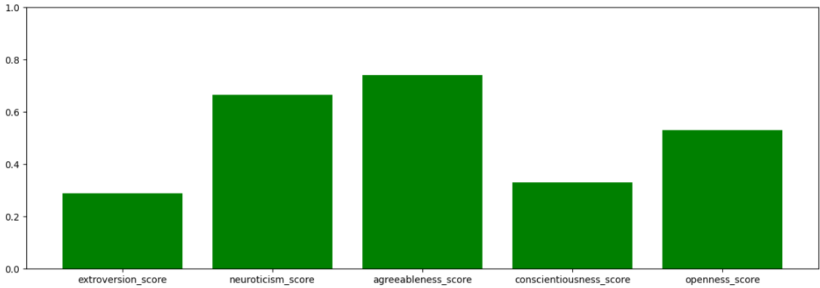
AI
Results
Fig 3 Scores for different personality types for cluster 1

Slide 14
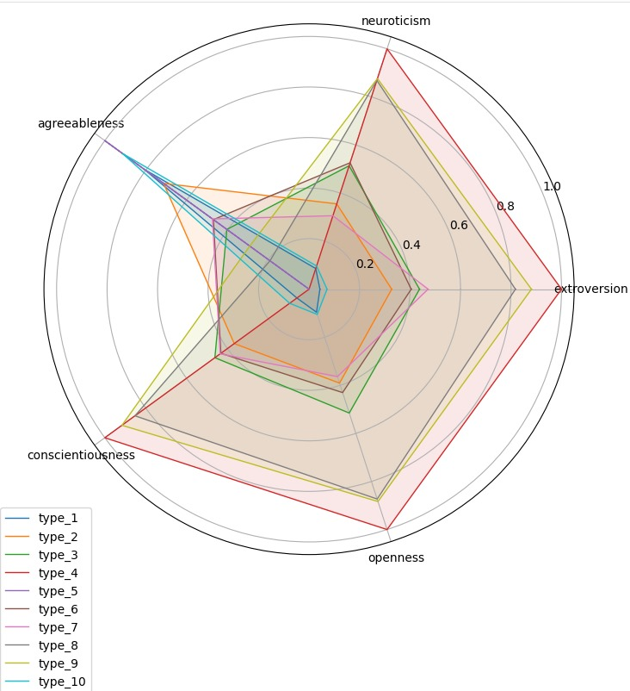
Results
Fig 4. Radar Chart representing to identify strengths and weaknesses of
each trait in each clustering

Slide 15
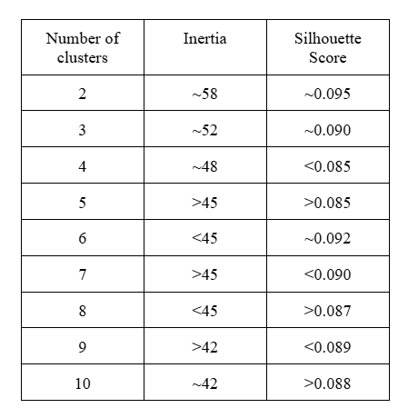
Results
Fig 5. Inertia and silhouette scores for each clusters

Slide 16
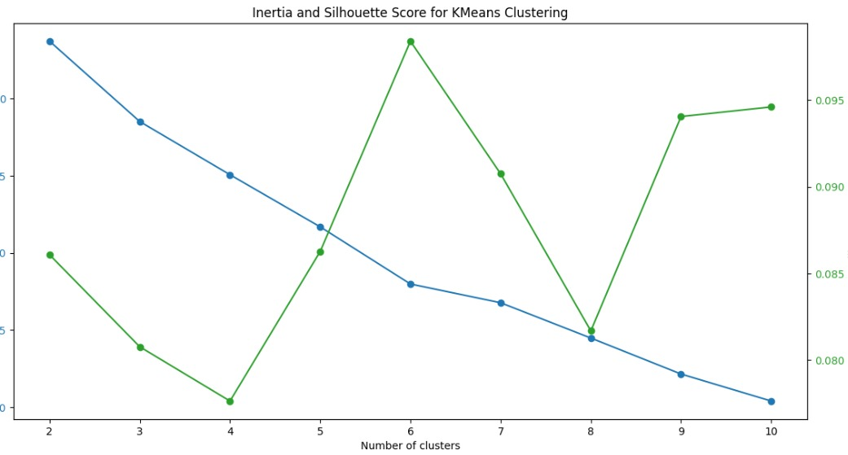
Results
Fig. 6 Analyzing performance of K-Means of inertia and
Silhouette Score clustering

Slide 17
References
[1] Gottfredson, G.D., and J.L. Holland, “Dictionary of Holland Occupational Codes,” Psychological Assessment Resources Incorporated, (1996).
[2] Hicks, S.C., R. Liu, Y. Ni, E. Purdom, and D.
Risso, “mbkmeans: Fast clustering for single cell data using mini-batch k-means,” PLoS computational biology, 17 (1), p. e1008625 (2021).
[3] Saucier, Gerard, and Lewis R. Goldberg. "What is beyond the Big Five?."(1998)
[4] Y. Mehta, S. Fatehi, A. Kazameini, C. Stachl, E. Cambria and S. Eetemadi, "Bottom-Up and Top-Down: Predicting Personality with Psycholinguistic and Language Model Features,"
[5] Batista, Jonatan Santana, and Sônia Maria Guedes Gondim. 2023. "Personality and Person-Work Environment Fit”
[6] N. Majumder, S. Poria, A. Gelbukh, and E. Cambria, “Deep learning based document modeling for personality detection from text.” (2017)
[7] Y. Mehta, N. Majumder, A. Gelbukh, and E. Cambria, “Recent trends in deep learning based personality detection”.
[8] Khan, Alam Sher, et al. "Personality classification from online text using machine learning approach."(2020)
[9] F. Mairesse, M. A. Walker, M. R. Mehl, and R. K. Moore, “Using linguistic cues for the automatic recognition of personality in conversation and text.”
[10] Hicks, S.C., R. Liu, Y. Ni, E. Purdom, and D. Risso, “mbk means: Fast clustering for single cell data using mini-batch k-means,” PLoS computational biology, 17 (1), p. e1008625 (2021).

Slide 18
Discussion
In this paper, we have proposed a system by showcasing the effectiveness of machine learning algorithms in predicting the career path of the student. This project shows the key insights into the link between the Big Five traits and Holland’s RIASEC career type. This system is trained and data predictive models by using repositories of personality traits using Big Five Personality - and mapping each of the personality to Holland’s code vocational career namely RIASEC. Also, by using K-Means Clustering maps the personality traits with the careers well.
Also, by using K-Means Clustering maps the personality traits with the careers well.The clustering finds the clear personality groups that align closely with the RIASEC Type.
In contrast to previous studies that looked at the Big Five Personality traits and Holland’s RIASEC codes separately, this study stands out by combining these two frameworks with the advanced machine learning techniques to provide more accurate insights to choose career paths.

Slide 19
THANK YOU

